Slide 1
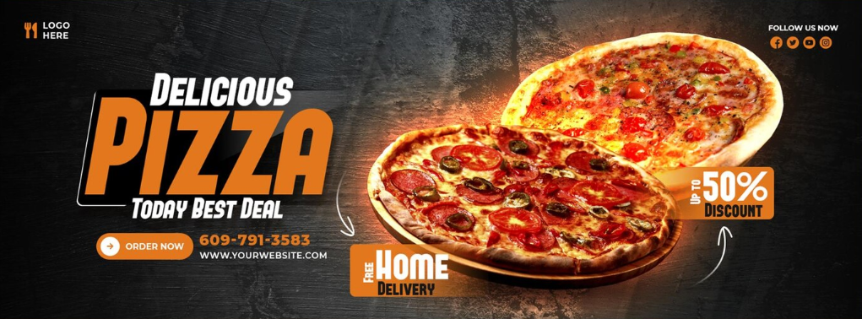
Pizza Sales Report for Business Growth

Slide 2
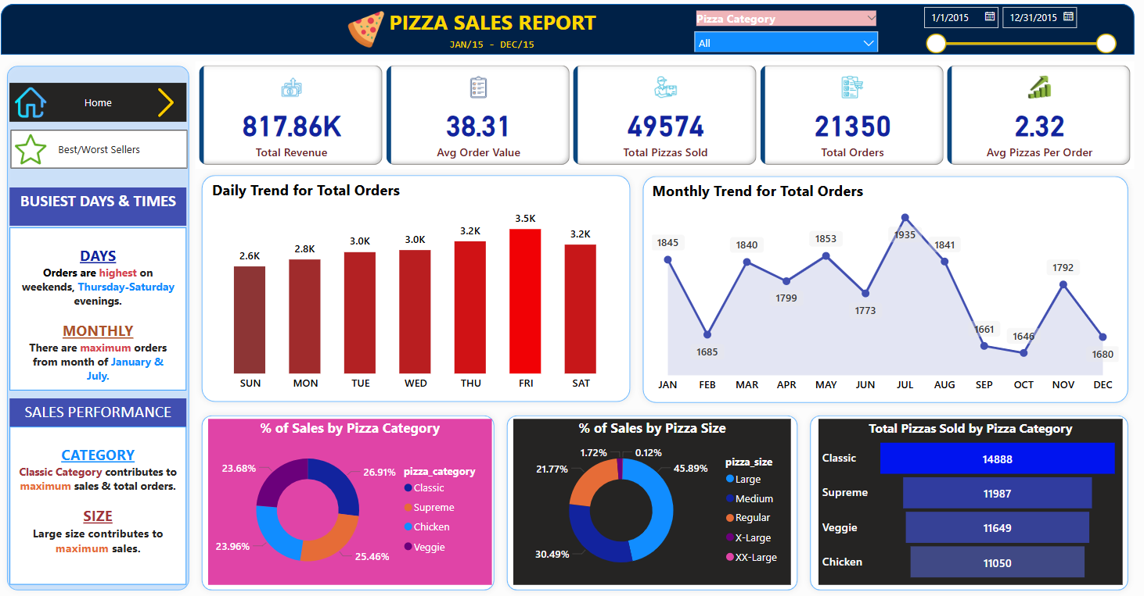

Slide 3
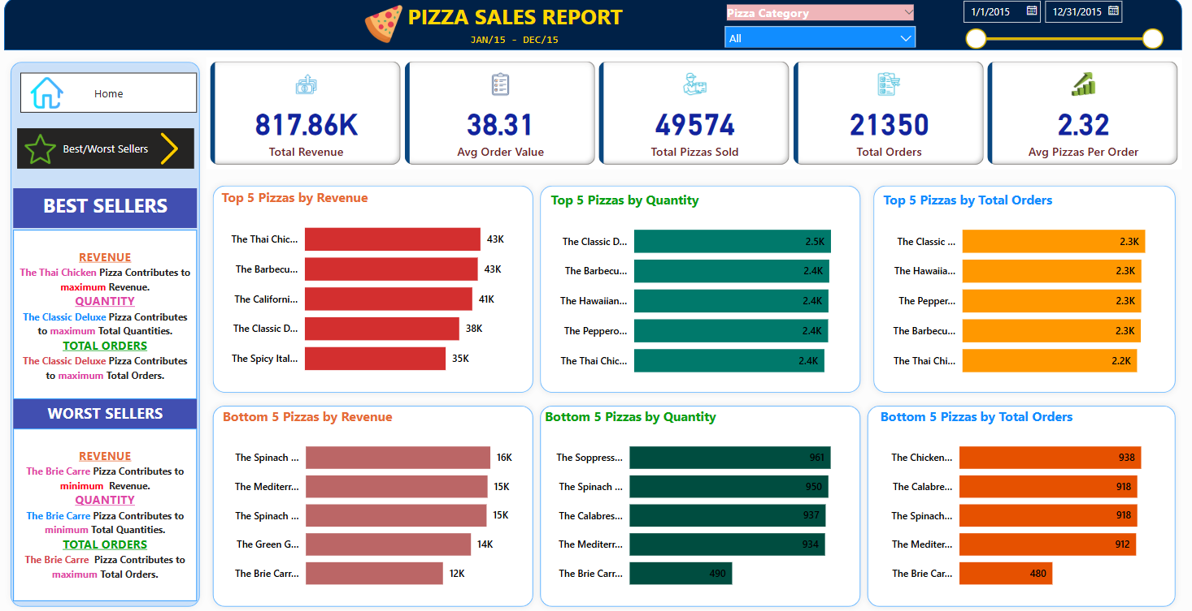

Slide 4
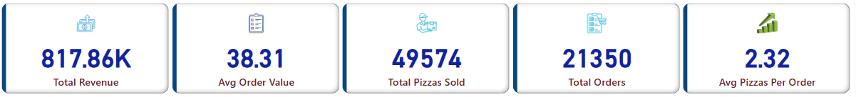
KPI’s Report
Total Revenue gathered is 817860.
Average Order Value is 38.31
Total Pizzas Sold are 49,574.
Total Orders made are 21,350.
Average Pizzas Per Order is 2.32.

Slide 5
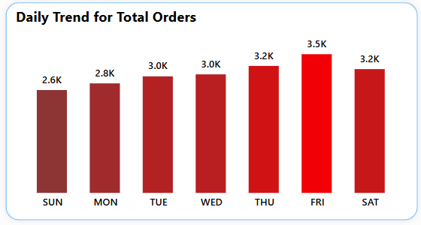
Daily Trend for Total Orders
Highest activity on Fridays.
Lowest demand on Sundays.
Orders gradually increase from Monday to Thursday.

Slide 6
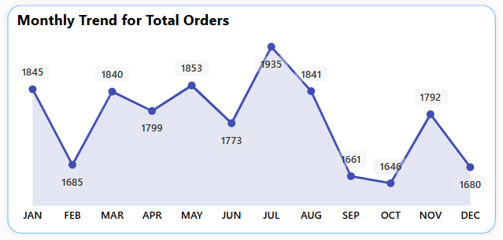
Monthly Trend for Total Orders
January starts with 1,845 orders but drops in February (1,685).
Highest peak in July (1,935 orders).
August follows closely (1,841 orders) before a sharp drop in September (1,661).
November rises again (1,792 orders) before December's decline (1,680).
Fluctuations with peaks in May, July, and November.
Seasonal demand affects order trends.
Peaks in mid-year and before the holiday season suggest strategic marketing opportunities.
November increase aligns with holiday shopping trends.

Slide 7
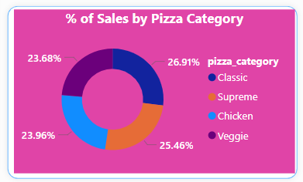
Percentage of Sales by Pizza Category
Classic category has the highest sales share at 26.91%.
Supreme follows closely with 25.46%.
Chicken contributes 23.96%.
Veggie has the lowest sales share at 23.68%.

Slide 8
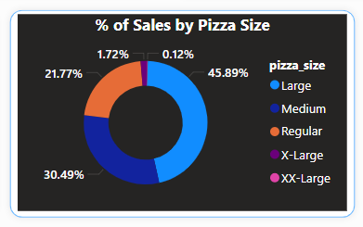
Percentage of Sales by Pizza Size
Large pizzas dominate sales (45.89%), followed by Medium (30.49%).
Regular pizzas (21.77%) have moderate sales.
X-Large (1.72%) & XX-Large (0.12%) contribute very little to sales.

Slide 9
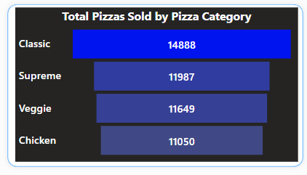
Total Pizzas Sold by Category
Classic is the best-selling pizza (14,888 units).
Supreme (11,987) & Veggie (11,649) have nearly similar sales.
Chicken (11,050) has the lowest sales.

Slide 10
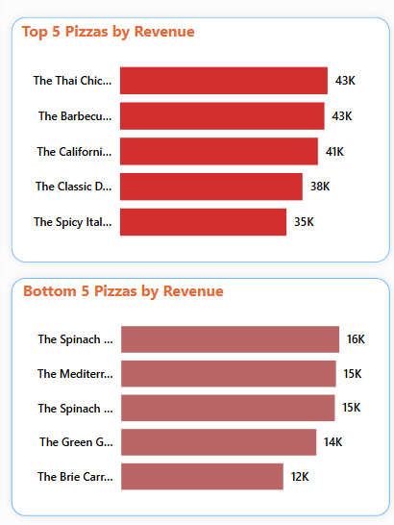
5 Top & Bottom Pizza by Revenue
Top-selling pizzas are; The Thai Chicken Pizza (43K), followed by The Barbecue Pizza (43K), The California Pizza(41K), The Classic Deluxe Pizza (38K), The Spicy Italian Pizza (35K).
Lowest revenue pizzas are: The Brie Carre Pizza (12K), The Green Garden Pizza (14K), The Spinach and Mushroom Pizza (15K), The Mediterranean Veggie Pizza (15K), The Spinach Alfredo Pizza (16K).
Revenue gap between top and bottom performers is significant.

Slide 11
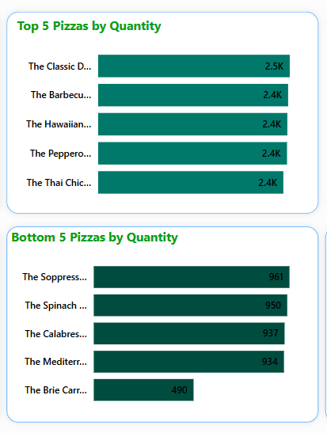
5 Top & Bottom Pizza by Total Quantity
The Classic Deluxe Pizza leads in sales (2.5K units) indicating strong customer preference.
The Barbecue, The Hawaiian, The Thai Chicken and The Pepperoni Pizzas are top choices, showing demand for traditional & meaty flavors.
The Brie Carre Pizza struggles significantly (only 490 units sold), needing urgent intervention.
Bottom 5 pizzas have sales under 1K, showing limited popularity.

Slide 12
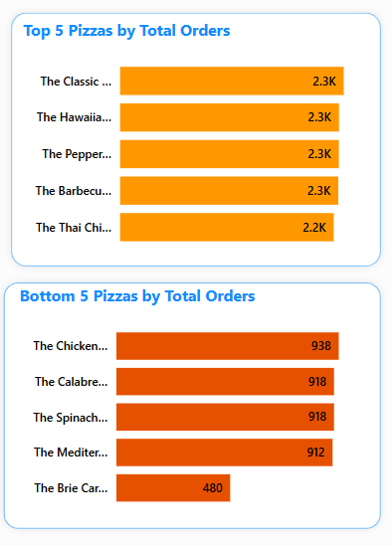
5 Top & Bottom Pizza by Total Orders
Top-selling pizzas exceed 2.2K orders each, showing strong customer demand for classic and meaty flavors.
The Brie Carre Pizza remains the lowest performer with only 480 orders, consistent with previous insights on poor performance. The Chicken Alfredo, The Calabrese, and The Spinach Alfredo are under 1K orders, indicating a need for strategic intervention.
Orders align closely with sales quantity trends, reinforcing the popularity of certain flavors.

Slide 13
Recommendations
1. Boost Sales with Strategic Marketing;
Increase Veggie & Chicken Pizza Sales - Highlight nutritional benefits, introduce new flavors, and offer meal deals.
Make Supreme & Classic Pizzas Category More Popular – Promote bestsellers, add premium options, and reward loyal customers.
Use Sales Data Well – Offer discounts at the right time and adjust prices based on demand.

Slide 14
Recommendations
2. Improve Menu & Stock;
Focus on Bestsellers (Thai Chicken & The Classic Deluxe Pizzas) – Always have enough stock, create combos, and reward loyal buyers.
Revamp Low-Performing Pizzas (Brie Carre & The Mediterranean Veggie Pizza ) - Get customer feedback, test discounts, or remove if still not selling.
Manage Stock Wisely – Buy ingredients in bulk for top-sellers and reduce waste on slow-moving pizzas.

Slide 15
Recommendations
3. Improve Sales Channels & Customer Engagement;
Boost High-Traffic Days (Thursday-Saturday) - Open longer, offer weekend deals.
Increase Sales on Low-Traffic Days (Monday-Tuesday) - Offer "Buy One, Get One Free" or Happy Hour discounts.
Grow Online & Delivery Orders – Make ordering easier, give discounts for early orders, and offer free delivery during slow hours.
Engage Customers – Let them vote for “Pizza of the Month,” collect feedback, and reward reviews with discounts.

